Slide 1
HTML5: Lesson #2

Slide 2
Agenda
HTML tables
HTML lists
div and span elements
Definition of Semantic Markup
New HTML5 Elements
Deprecated Elements
Practice task
Homework

Slide 3
HTML Tables
The HTML tables allow to arrange data like text, images, links, other tables, etc. into rows and columns of cells.
<table> defines overall table
<tr> defines rows
<th> defines column headers
<td> defines cells
<caption> adds a caption above or below table
Long, scrolling tables use <thead>, <tfoot>, and <tbody> tags
Notes:
Tip: Add your own speaker notes here.

Slide 4
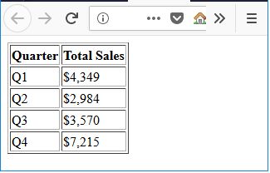
HTML Table Example
<table border="1"> <tr> <!-- first row --> <th>Quarter</th> <!-- first column in first row --> <th>Total Sales</th> <!-- first row, second column --> </tr> <tr> <!-- second row --> <td>Q1</td> <td>$4,349</td> </tr> <tr> <!-- third row --> <td>Q2</td> <td>$2,984</td> </tr> <tr> <!-- fourth row --> <td>Q3</td> <td>$3,570</td> </tr> <tr> <!-- fifth row --> <td>Q4</td> <td>$7,215</td> </tr> </table>
Notes:
Tip: Add your own speaker notes here.

Slide 5
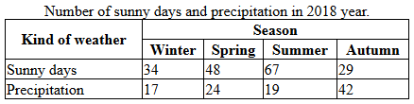
HTML colspan, rowspan
<table width="40%"> <caption>Number of sunny days and precipitation in 2018 year.</caption> <tr> <th rowspan="2">Kind of weather</th> <th colspan="4">Season</th> </tr> <tr> <th>Winter</th> <th>Spring</th> <th>Summer</th> <th>Autumn</th> </tr> <tr> <td>Sunny days</td> <td>34</td> <td>48</td> <td>67</td> <td>29</td> </tr> <tr> <td>Precipitation</td> <td>17</td> <td>24</td> <td>19</td> <td>42</td> </tr> </table>
<style> table, th, td { border: 1px solid black; border-collapse: collapse; } </style>
Notes:
Tip: Add your own speaker notes here.

Slide 6
HTML Lists
There are three list types in HTML:
ordered list – used to group a set of related items in a specific order
unordered list – used to group a set of related items in no particular order
description list – used to display name/value pairs such as terms and definitions
Notes:
Tip: Add your own speaker notes here.

Slide 7
Ordered List
Ordered lists use one set of <ol> tags wrapped around one or more sets of <li> tags:
The <ol> tag can include attributes:
reversed: reverses the order of the list
start: specifies the start value of the ordered list
type: specifies list item marker, such as "1" for displaying decimal numbers
Notes:
Tip: Add your own speaker notes here.

Slide 8
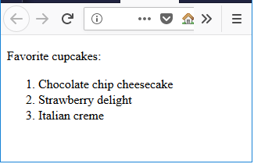
Ordered List Example
<p>Favorite cupcakes:</p> <ol> <li>Chocolate chip cheesecake</li> <li>Strawberry delight</li> <li>Italian creme</li> </ol>
Notes:
Tip: Add your own speaker notes here.

Slide 9
Unordered List
Unordered lists use one set of <ul> tags wrapped around one or more sets of <li> tags:
Round bullet symbol is the default marker for list items
Can change bullet symbols
For squares, add to the <ul> tag
For empty circles, add
type="square"
type="circle"
Notes:
Tip: Add your own speaker notes here.

Slide 10
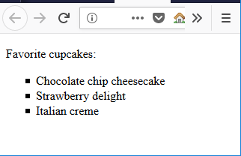
Unordered List Example
<p>Favorite cupcakes:</p> <ul type="square"> <li>Chocolate chip cheesecake</li> <li>Strawberry delight</li> <li>Italian creme</li> </ul>
Notes:
Tip: Add your own speaker notes here.

Slide 11
Description List
Description lists use one set of <dl> tags wrapped around one or more groups of <dt> (name) and <dd> (value) tags.
You must pair at least one <dt> with at least one <dd>, and the <dt> should always come first in the source order.
Notes:
Tip: Add your own speaker notes here.

Slide 12
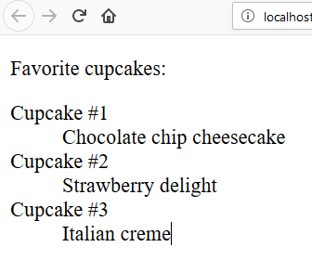
Description List Example
<p>Favorite cupcakes:</p> <dl> <dt>Cupcake #1</dt> <dd>Chocolate chip cheesecake</dd> <dt>Cupcake #2</dt> <dd>Strawberry delight</dd> <dt>Cupcake #3</dt> <dd>Italian creme</dd> </dl>
Notes:
Tip: Add your own speaker notes here.

Slide 13
div Element
The <div> tag defines a division or a section in an HTML document.
The <div> element is often used as a container for other HTML elements to style them with CSS or to perform certain tasks with JavaScript.
Notes:
Tip: Add your own speaker notes here.

Slide 14
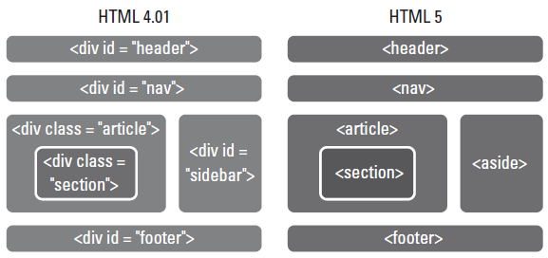
div Element
The <div> tag used for years to create structure of an HTML document.
Often includes a class or id attribute.
Example:
Notes:
Tip: Add your own speaker notes here.

Slide 15
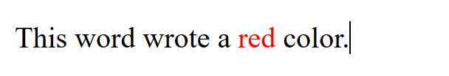
span Element
The <span> tag is used to group inline-elements in a document.
The <span> tag provides no visual change by itself.
When a text is hooked in a <span> element, you can style it with CSS, or manipulate it with JavaScript.
Example:
<p>This word wrote a
<span style="color:red">red</span>
color.</p>

Slide 16
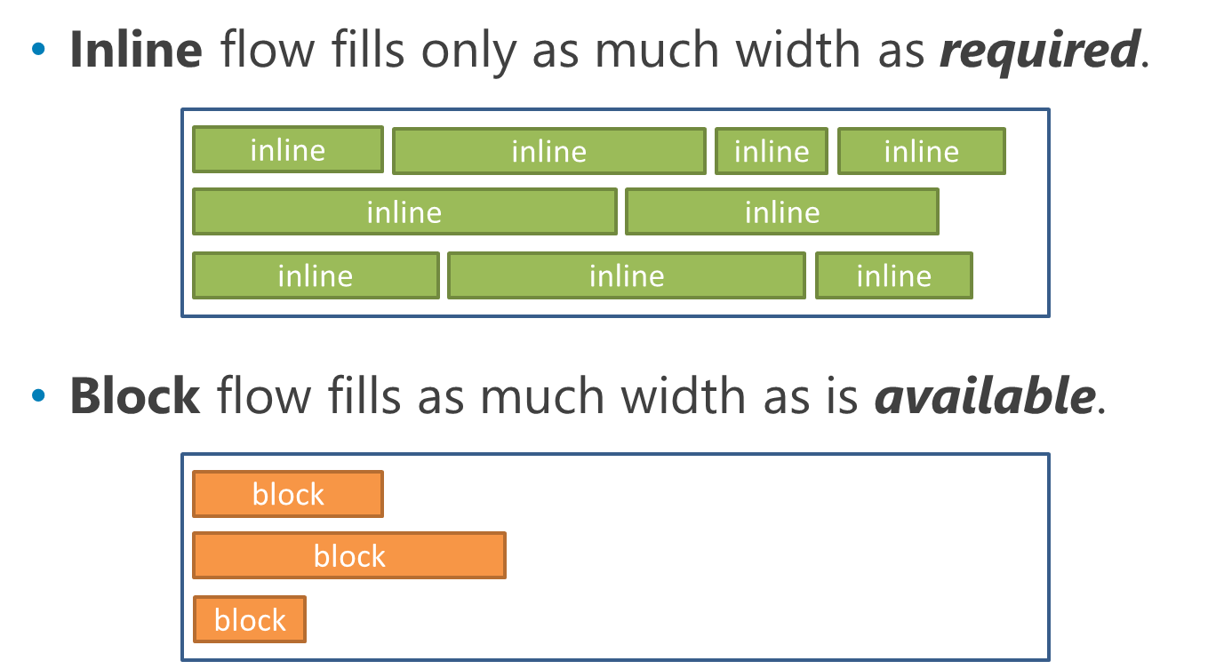
Block and Inline Elements
Every HTML element has a default display value depending on what type of element it is.
The default display value for most elements is block or inline.

Slide 17
New HTML5 Elements for Structuring and Organizing Content
Use tags <header>, <footer>, <section>, <nav>, <article>, and <aside> now!
Notes:
Tip: Add your own speaker notes here.

Slide 18
Semantic Markup
Tag names that are intuitive.
Makes it easier to build and modify HTML documents.
Makes it easier for Web browsers and other programs to interpret.
Developers can still use <div> in HTML5 documents, but should use new structure elements whenever appropriate.
Notes:
Tip: Add your own speaker notes here.

Slide 19
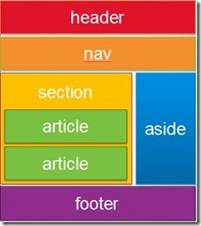
Better semantic tags
HTML5 offers new semantic elements to clearly define different parts of a web page:
<header>
<nav>
<main>
<aside>
<footer>
<section>
<article>
Notes:
Tip: Add your own speaker notes here.

Slide 20
header and footer Elements
The <header> element defines a header for a document, section, or article.
HTML 4.01 uses tag <div> with id attribute ( ).
The <footer> element defines a footer for a document or section, and typically contains information about the document or section, such as the author name, copyright data, links to related documents, and so on.
<div id="header">
Notes:
Tip: Add your own speaker notes here.

Slide 21
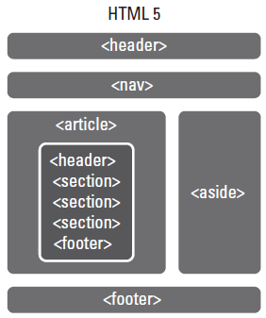
header and footer Elements (continued)
Can include multiple headers or footers in an HTML5 document
Notes:
Tip: Add your own speaker notes here.

Slide 22
header and footer Markup Example
<article> <header> <h1>Learning HTML5</h1> </header> <p>Here comes my text</p> <footer> <p>Published <time datetime="2016-03-19">March 19, 2016</time> </p> </footer> </article>
Notes:
Tip: Add your own speaker notes here.

Slide 23
article Element
The tag <article> defines a part of an HTML document that consists of a “self-contained composition” independent from the rest of the content in the document.
Potential sources for the <article> element:
Blog post
News story
Comment
Notes:
Tip: Add your own speaker notes here.

Slide 24
section Element
The tag <section> defines a section in a document, such as a chapter, parts of a thesis, or parts of a Web page whose content is distinct from each other.
According to the W3C, must contain at least one heading.
Notes:
Tip: Add your own speaker notes here.

Slide 25
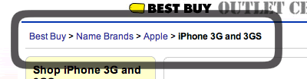
nav Element
The tag <nav> defines a block of navigation links and is useful for creating:
A set of navigation links as a document’s primary navigation;
A table of contents;
Previous-Home-Next links.
Breadcrumbs in a header;
Notes:
Tip: Add your own speaker notes here.

Slide 26
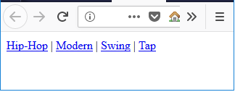
nav Example
<nav> <a href="/hiphop/">Hip-Hop</a> | <a href="/modern/">Modern</a> | <a href="/swing/">Swing</a> | <a href="/tap/">Tap</a> </nav>
Notes:
Tip: Add your own speaker notes here.

Slide 27
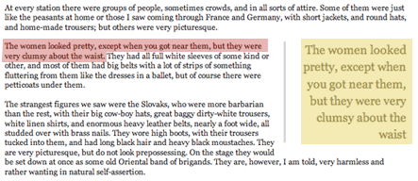
aside Element
The tag <aside> used for sidebars and notes-content that’s related to the current topic but would interrupt the flow of the document if left inline.
Notes:
Tip: Add your own speaker notes here.

Slide 28
HTML 4 Text-related Elements with New Meaning or Functionality in HTML5
The <b> element should now be used to offset text without conveying importance, such as for keywords, product names, etc.
The <strong> element indicates strong importance.
The <i> element should now be used to indicate a technical term, a phrase from another language, etc.
The <em> element indicates emphatic stress.
Notes:
Tip: Add your own speaker notes here.

Slide 29
Other Phrase Tags
<abbr>: Defines an abbreviation or an acronym
<address>: Defines contact information for the author/owner of a document
<blockquote>: Defines a section that is quoted from another source
<cite>: Defines the title of a work
<code>: Defines a piece of computer code.
<dfn>: Represents the defining instance.
<kbd>: Defines keyboard input.
<mark>: Defines marked/highlighted text
<samp>: Defines sample output from a computer program.
<small> Define a smaller text for small print.
<var>: Defines a program variable.
<q>: Defines a short quotation
Notes:
Tip: Add your own speaker notes here.

Slide 30
Deprecation
While new elements become available, the W3C earmarks other elements for eventual removal because their functionality is no longer useful.
Removing elements from the list of available HTML elements is referred to as deprecation.
Note: The same thing applies to attributes and CSS properties.
Notes:
Tip: Add your own speaker notes here.

Slide 31
Deprecated in HTML5 Elements
<big>: Defined big text
<center>: Defined centered text
<font>: Defined font, color, and size for text
<applet>: Defined an embedded applet
<frame>: Defined a window (a frame) in a frameset
The fix: Use CSS instead
https://www.w3schools.com/tags/default.asp
https://www.w3schools.com/tags/ref_attributes.asp
Notes:
Tip: Add your own speaker notes here.

Slide 32
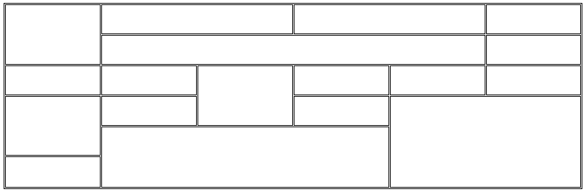
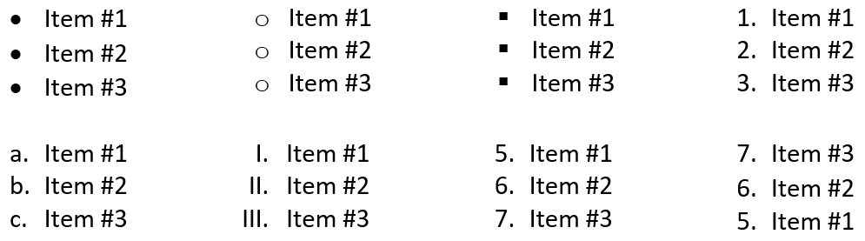
Practice task
Create the HTML table with next structure:
Create lists (ordered and unordered)

Slide 33
Homework
Go to page: https://www.w3schools.com/tags/ and to examine with all HTML Tags.

Slide 34
Contacts
Europe Headquarters
52 V. Velykoho Str.
Lviv 79053, Ukraine
Tel: +380-32-240-9090 Fax: +380-32-240-9080
E-mail: info@softserveinc.com
Website: www.softserveinc.com
US Headquarters
12800 University Drive, Suite 250 Fort Myers, FL 33907, USA
Tel: 239-690-3111 Fax: 239-690-3116
Thank You!

